Slide 1
SPATIAL AUGMENTED REALITY
PROJECTION - BASED
(The title is funny because it means different things depending on where you put the emphasis)

Slide 2
Introduction
What is AR?
Where does it happen?
What can you do with projectors?

Slide 3
Spatial Augmented Reality
+
Physical Object
Digital Information
Physical Space

Slide 4
Display location: Body vs Space
Retinal
Display
Head-worn
Helmet
Augmented
object
Light path
Hand-held Display
See-through window in space
ON BODY
(A.K.A. See-through)
SPATIAL
(Actual See-Through)

Slide 5
So, spatial only means «not on the user » we do projector-based (S)AR

Slide 6
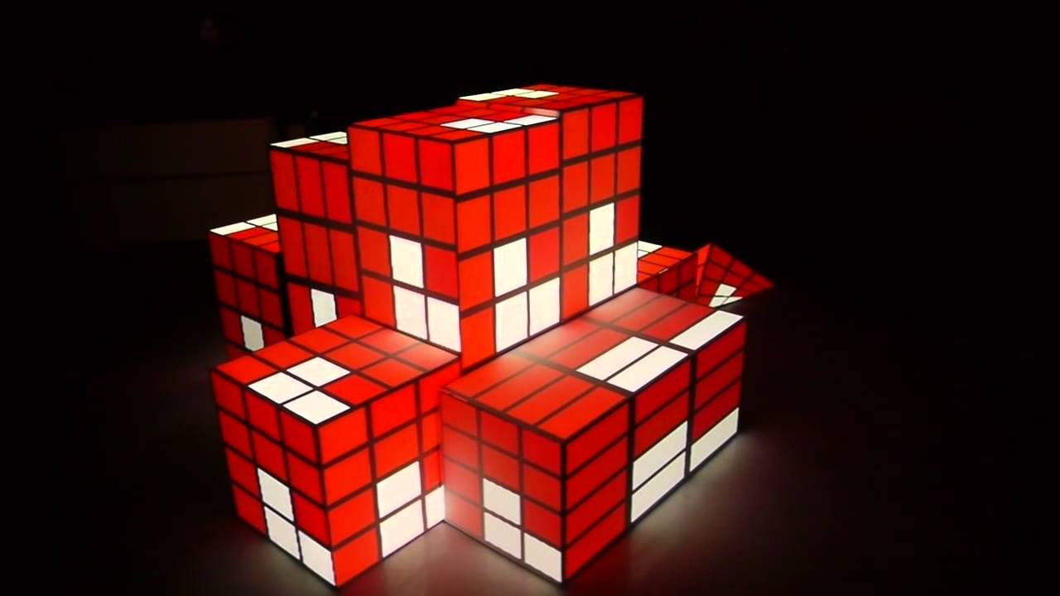
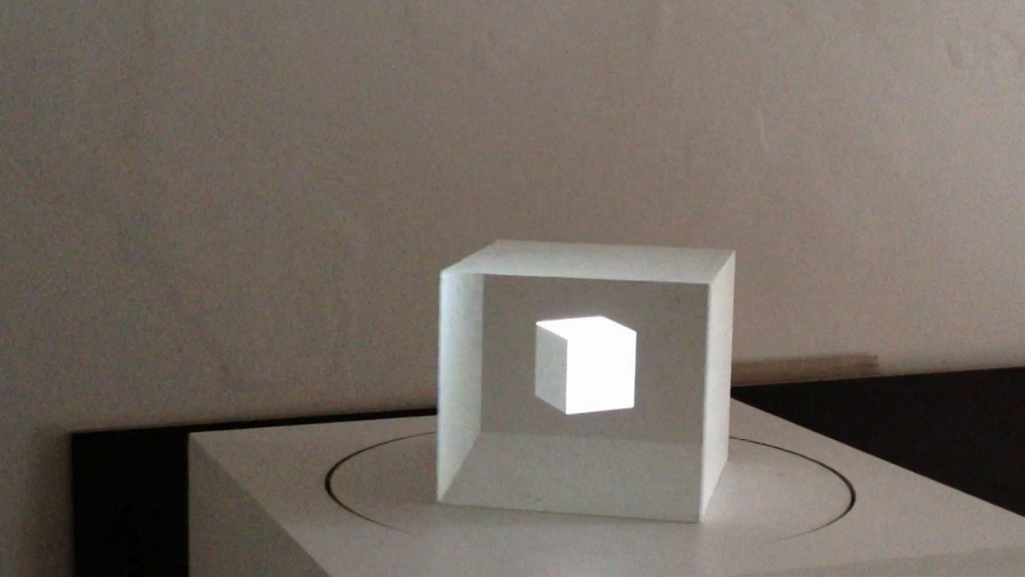
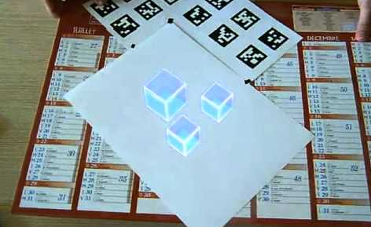
Physical-Digital relationship
+
=
+
=
Texture mapping (Physical geometry == Digital geometry)
Anamorphic illusions (Physical geometry != Digital geometry)

Slide 7
Image location: co-located
Surface
augmentation
User’s eye
Physical
object
Virtual
object
User’s FoV

Slide 8
Image location: virtual behind of physical
See-through
image
User’s eye
Virtual
object
Physical
support
User’s FoV

Slide 9
Image location: virtual in front of physical
Virtual
object
User’s eye
“shadow”
User’s FoV
Physical
support

Slide 10
Image location: virtual in front of physical
Virtual
object
User’s eye
Anamorphic “shadow”
User’s FoV
Physical
support

Slide 11
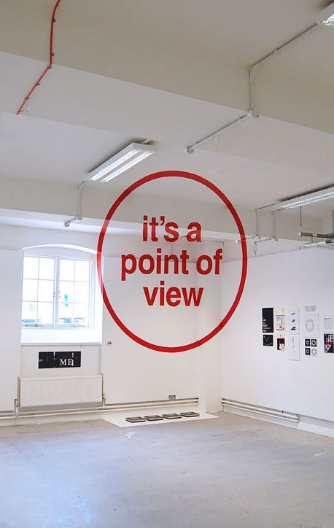
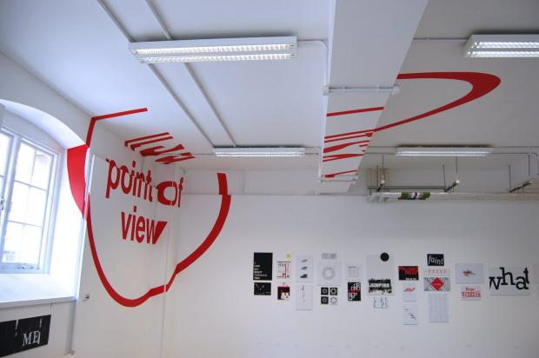
Image location: virtual in front of physical

Slide 12
Depth error
Virtual behind screen
Virtual in front of screen
Virtual object
Physical object
Depth
error
Depth error
Virtual
object
Monoscopic Display
Virtual
object
Focus distance
Depth
Depth
Vergence distance
Virtual object
Stereoscopic Display

Slide 13
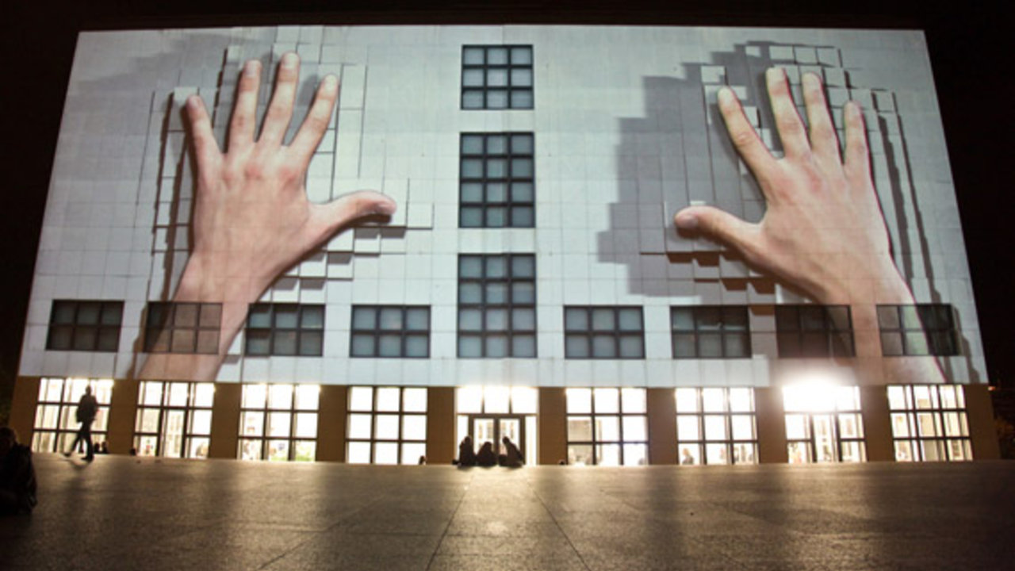

Slide 14
Each of these illusions can be created using projectors

Slide 15
Virtual object
Virtual object
Virtual object
Flat
screen
Arbitrary
screen
Object
Projector
Projector
Projector
User’s eye
User’s eye
User’s eye
1
Surface
Augmentation
2
Flat
Window
Arbitrary
Window
3

Slide 16
Optical devices
(cameras and projectors)

Slide 17
The pin camera model: The parts
Looking at the world, from a point, through a window
The world behind the window (everything, and in this case a cube)
Window (image plane)
World element
Principal point (image center)
This is you, looking at the world through a window
You (Optical center)

Slide 18
The pin camera model: the Field of view
World element
(X,Y,Z)
(U,V)
(Optical center)
(image plane)

Slide 19
The pin camera model: The Frustum
Frustum
The view and perspective of the camera
Things inside are visible, things outside are not
Far plane
World element
(Optical center)
Near plane

Slide 20
The pin camera model: The Depth
The depth is the distance to the object (normalized between near and far planes)
Frustum
Far plane
Depth
World element
(X,Y,Z)
(U,V)
(Optical center)
Near plane

Slide 21
Knowing the camera parameters
PROJECTION
(Shape of the Frustum)
FAR plane
Screen
World element
VIEW
(Camera position and orientation)
NEAR plane

Slide 22
How do these matrices look like?
Coordinate System
3D model
Picture
Calibration
Intrinsics
Extrinsics
Transform from View space to Screen space
Transfrom from World space to View space
Transfrom from Local to World space
Point in
local space
Point in
Screen space
=
Image(2D*)
View(3d)
World(3d)
Local(3d)

Slide 23
How do these matrices look like?
Coordinate System
3D model
Picture
Calibration
Intrinsics
Extrinsics
4x4 matrix normalized space to pixel, then divide by perspective
4x4 matrix (camera transform)⁻¹ as Affine transform (rotation, translation scale)
4x4 matrix
Object transform as affine transform (rotation, translation scale)
X Y Z
U, V (,Depth)
=
Image(2D*)
View(3d)
World(3d)
Local(3d)
One free variable, non-injective Rendering optionally shows what is nearest Stereo cameras intersect vectors

Slide 24
Pin hole model for see-through

Slide 25
Changing the camera and the image plane
Virtual element
1
WINDOW
World element
CAMERA POSITION
2

Slide 26
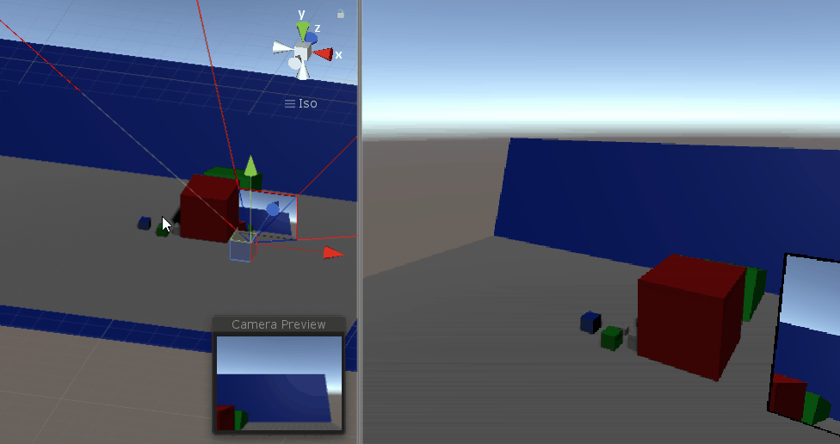
Example 4 See-through – fixed camera

Slide 27
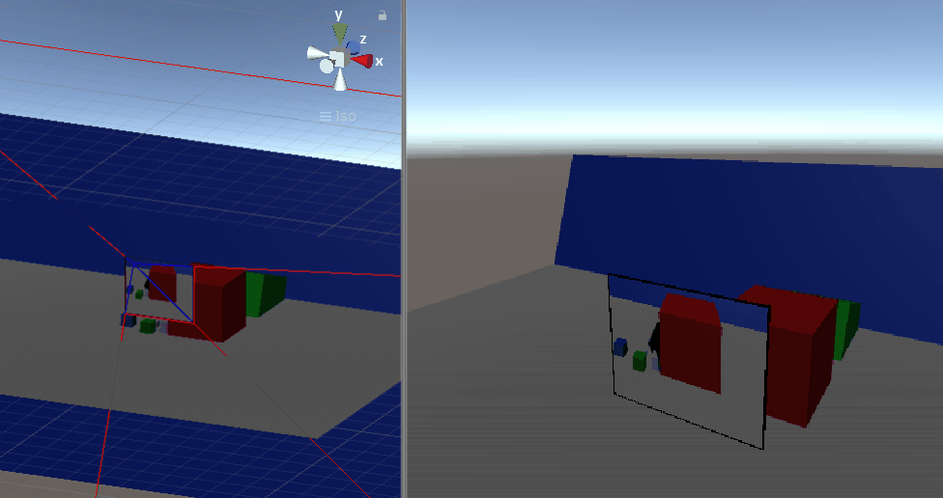
Example 5 See-through – independent camera

Slide 28
Understanding projectors

Slide 29
VIRTUAL CAMERA
(matching projector’s properties)
Augmentation
Image plane
Physical scene

Slide 30
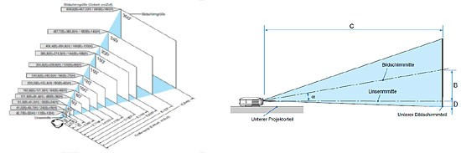
A projector is a reverse camera
But most of them are not symmetrical!
(vertical lens shift)
[Awful pictures]

Slide 31
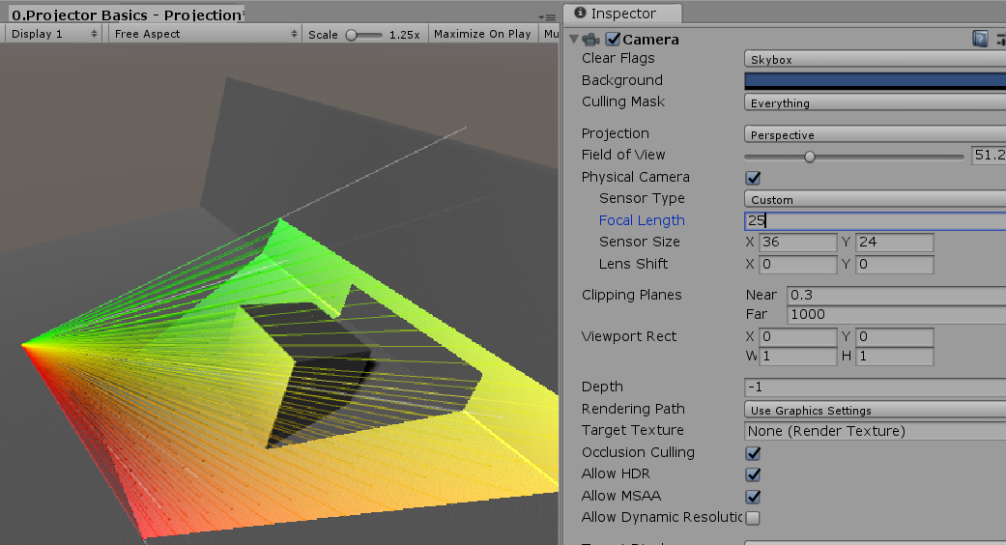
Example 1: Frustum

Slide 32
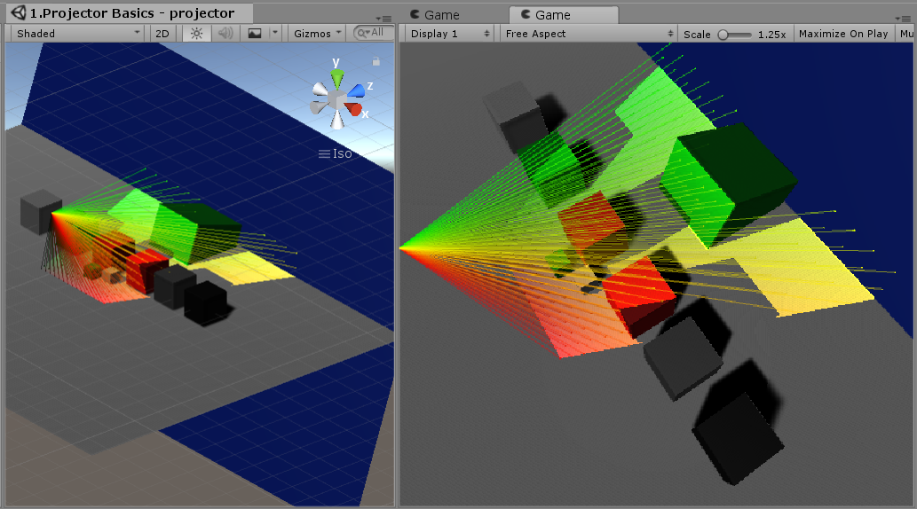
Example 2: materials

Slide 33
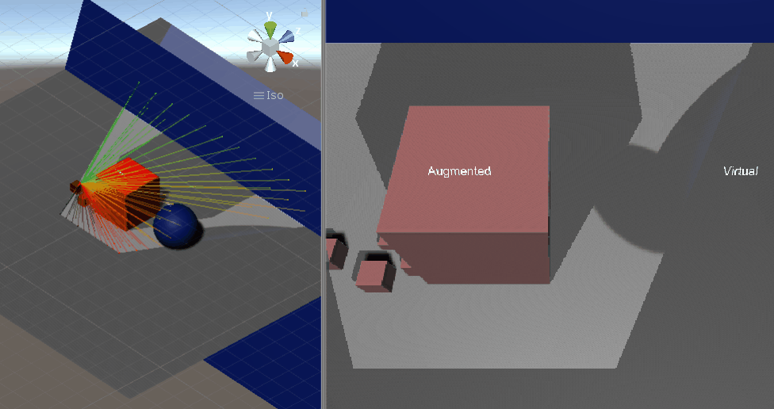
Example 3 Augmented surfaces vs virtual projection

Slide 34
CALIBRATING PROJECTORS

Slide 35
Example 1: Frustum

Slide 36
Calibration requires uv-xyz pairs
World element
(X,Y,Z)
(U,V)
(Optical center)
(image plane)

Slide 37
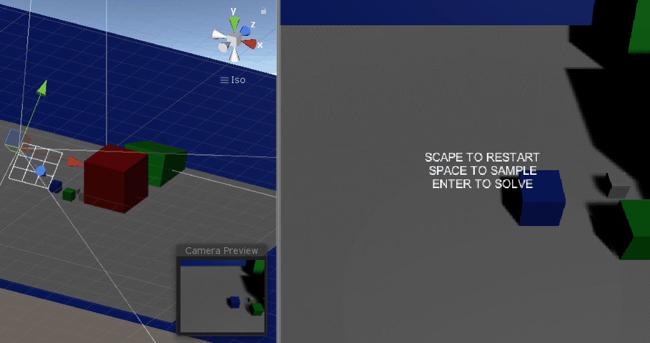
Example 4: Dummy calibration

Slide 38
Example 5: UV Picking (bad)

Slide 39
Example 5: Markers (decent/bad)

Slide 40
Example 5: Vision (decent /problematic)

Slide 41
 | UV coordinates | World coordinates
UV picking | Manually picked | Preselected/known
Using markers | Picked / preselected | Indicated using tracked object
Using Vision

Slide 42
Other problems

Slide 43
Image Distortion
y
y
y
y
x
x
x
x
No distortion
Radial distortion
(positive)
Radial distortion
(negative)
Tangential distortion

Slide 44
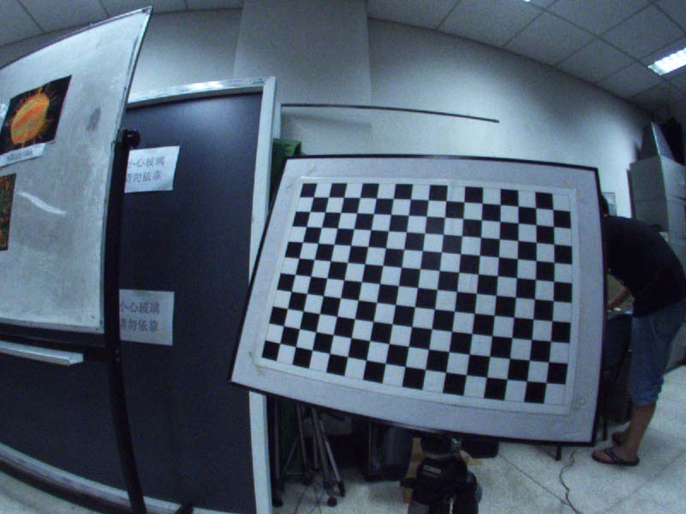

Slide 45
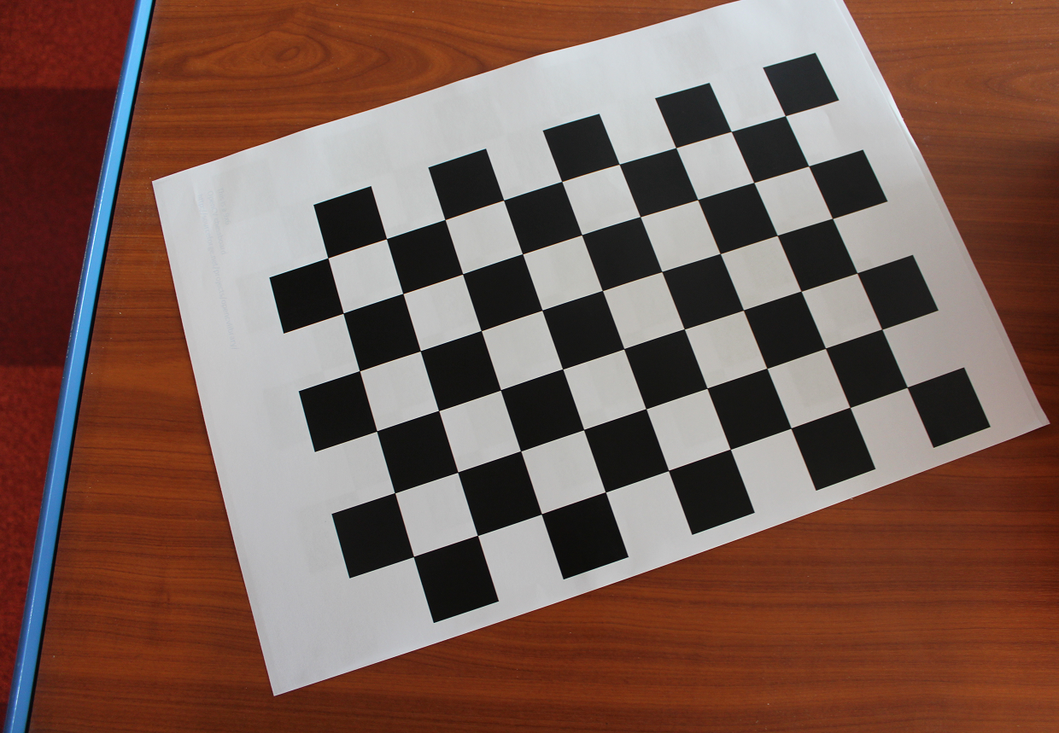
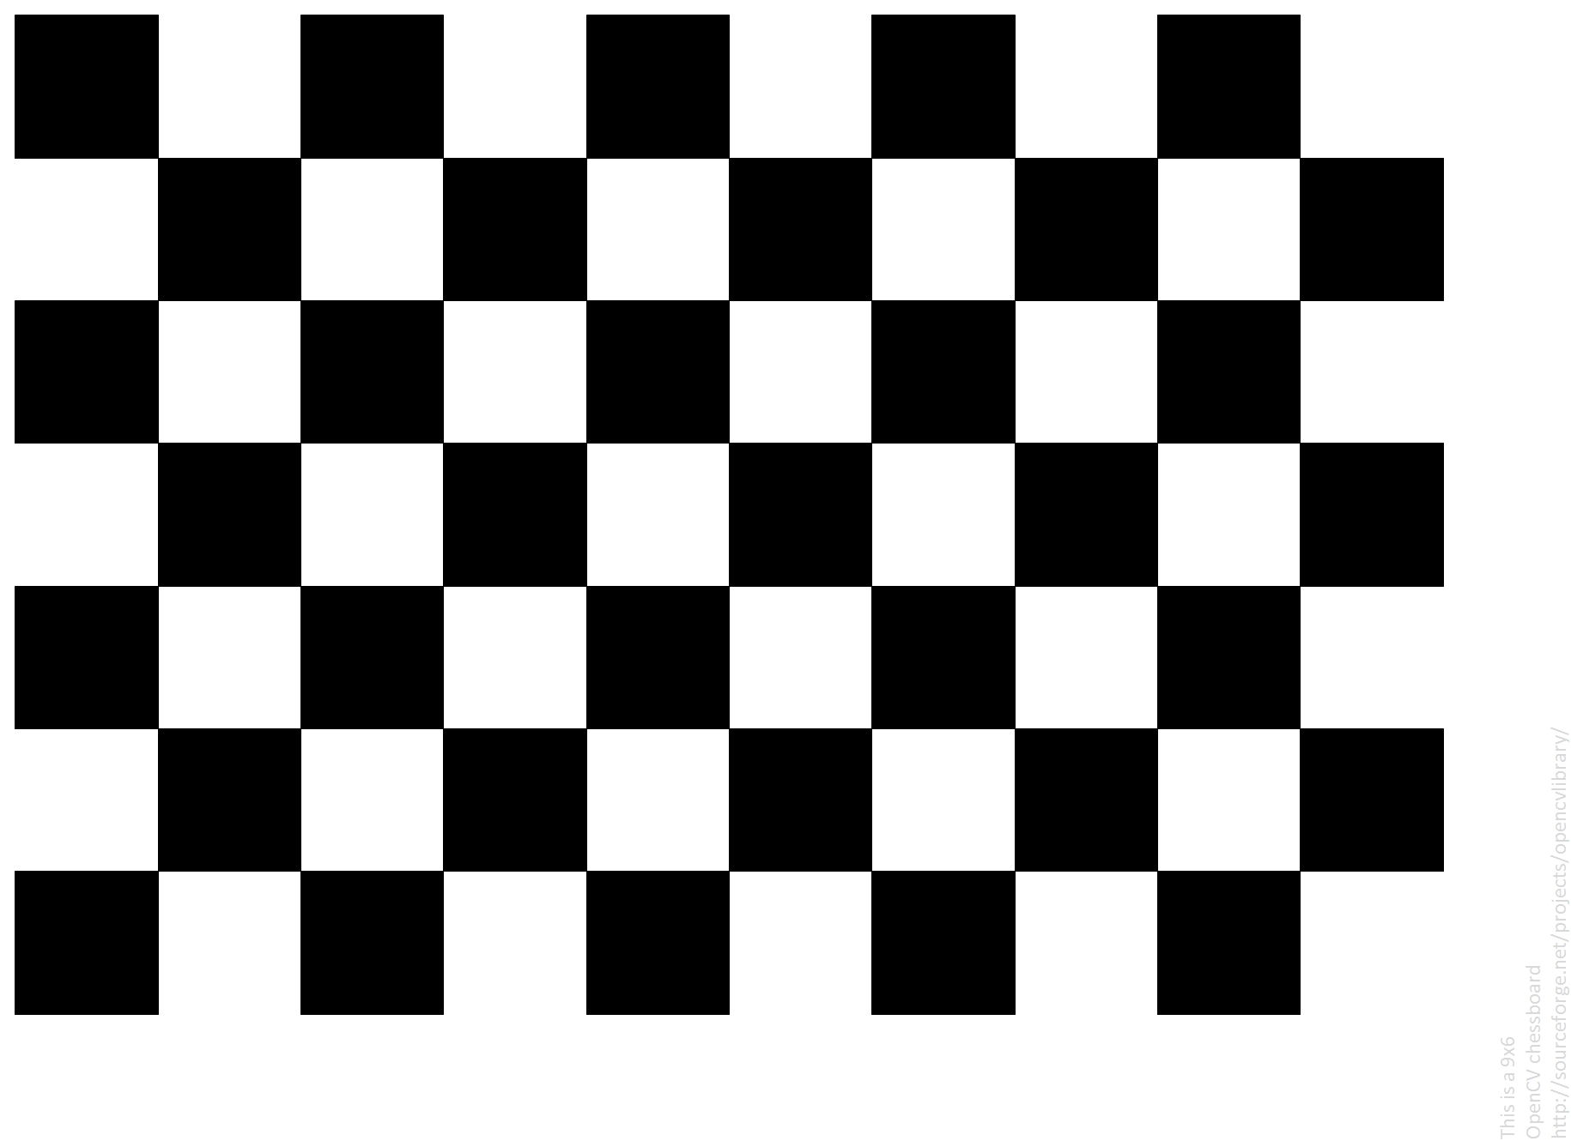
Width (cm)
Width (cm)
Height (cm)
Height (cm)
(X,Y,0)

Slide 46
Other stuff

Slide 47
Video See-through
2
VIDEO FEED
Virtual element
World element
1
CAMERA
link to WINDOW

Slide 48
The end

Slide 49
Chapters 7 to 9 APPLICATIONS
Appendix B
THE ACTUAL PATH
Asymmetric
collaboration
Well-being
Others
PART III
Chapter 4 to 6 HYBRID MIXED REALITY SYSTEMS
Building hybrid spaces
Interacting with hybrid spaces
Evaluating
Interaction
PART II
Chapter 3 SUPPORTING MIXED REALITY
Display modalities
Interaction modalities
PART I
Chapter 2
THEORY
Appendix A
IMPLEMENTATION
Mixed Reality
TUI
Understanding Cameras
Vision
Rendering

Slide 50
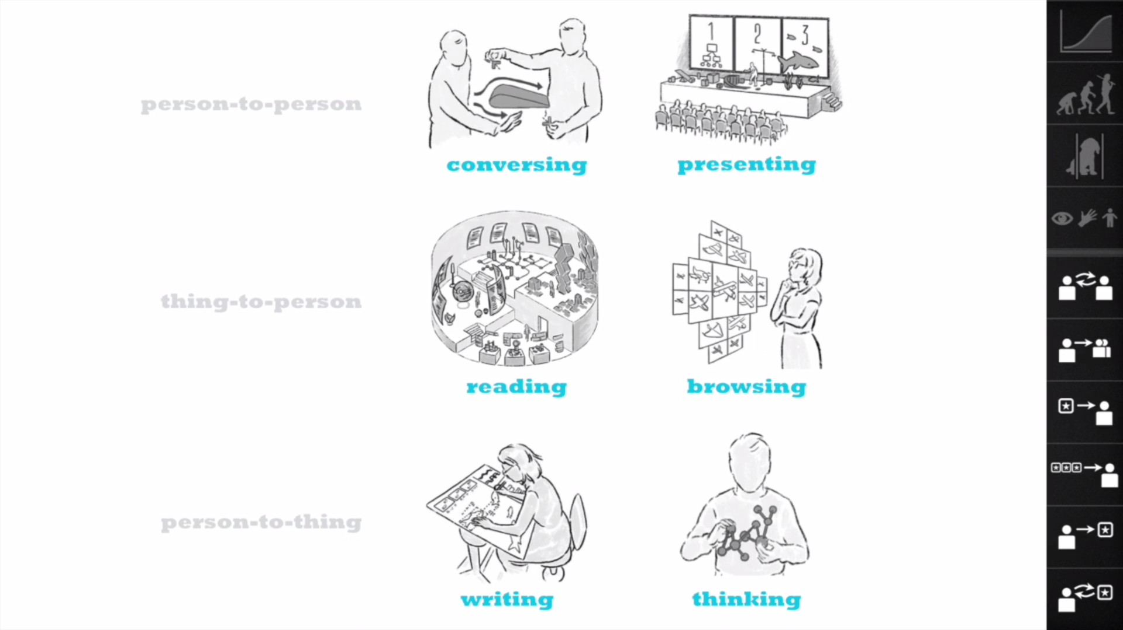
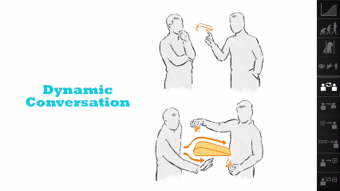
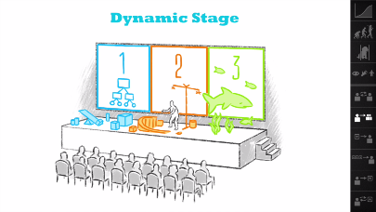
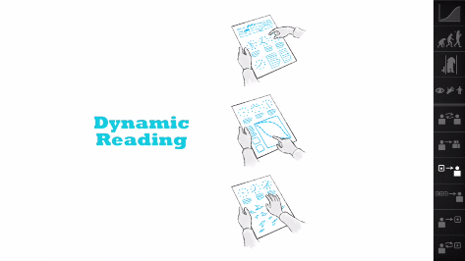
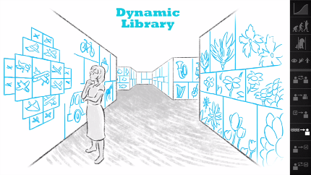
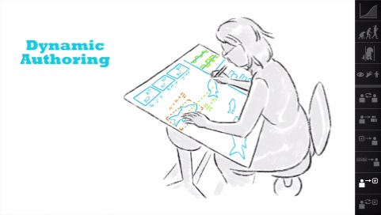
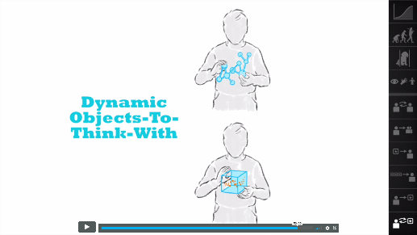
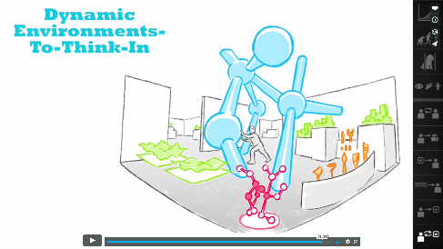

Slide 51

P
P
C
C
C
C
GAP
X
C
P
X
C
C
A
GUI
B
Virtual Reality (VR)
C
Ubiquitous Computers
D
Augmented Interaction
C
Computer world
Human – Physical World Interaction
Human – Computer World Interaction
P
Physical world
Computer World – Physical World Interaction

Slide 52
P
P
C
C
P
M
M
C
M
A
Terminal World
B
Enchanted Objects
C
Animism
D
Transhumanism
C
Computer
Human – Physical World Interaction
Human – Computer World Interaction
P
Physical
Computer World – Physical World Interaction
M
Computer+Physical
Human – Agent Interaction

Slide 53
Conversation
Presentation
Read
Create
Read
Spaces
Thing
Thing
Thing
Thing
Think
Thing

Slide 54
Physical world
Virtual
Environment
PRESENCE
Physical world
Virtual
Environment
OBJECT-PRESENCE

Slide 55
VIRTUAL
Were we come from: Computers as calculators
Were we are going: Ubiquitous Screens
1
WE ARE HERE
2
Virtual Reality
Augmented Reality
Were we could go: Integration
3
HERE
Tangible
UIs
Tele-
presence
THERE
Organic UIs
PHYSICAL

Slide 56
VIRTUAL
We come from: Computers as calculators
We are going towards: Ubiquitous Screens
1
2
Virtual Reality
Augmented Reality
Ubiquitous Computing
Augmented Virtuality
We think we should go towards: Smart objects and spaces
3
Tangible
Interaction
HERE
Tele-
presence
THERE
Ephemeral UIs
Organic UIs
PHYSICAL

Slide 57
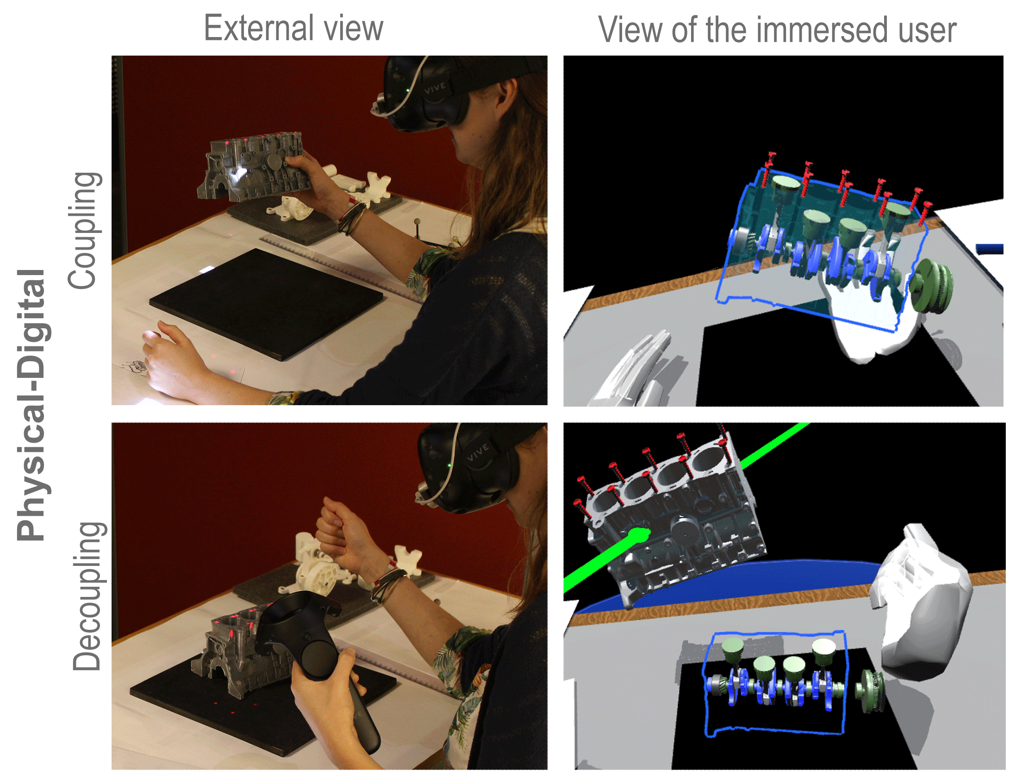
Object coupling
Object De-coupling

Slide 58
User’s eye
Virtual object
Projected shadow
1
Render scene
from user’s POV
2
Render the physical geometry
from projector POV. For each point:
Ask where it lays from the user’s POV
And use this information to sample the user’s POV render (1)
Physical
support

Slide 59
Projected VEs
Immersive VEs
Synthetic
Augmented
Reality
Desktop VEs
Tangible Bits
VEs Video Faces
ARTIFICIALITY
Videoconference
with shared data
Hybrid
Clearboard
Physical
meeting
Phone/video conference
media space (small screen)
Telepresence
Physical
Portland experience
Local
Partial
Remote
TRANSPORTATION
Benko’s collaborative MR
Synthetic
Billinghurst’s
MagicBook
Synthetic
Virtual
experiences
Augmented
experiences
Rekimoto’s Dollhouse
ARTIFICIALITY
Ullmer’s
MetaDesk
Kiyokawa’s work
ARTIFICIALITY
Hybrid
Hybrid
Tangibles
Collaborative
spaces
Telepresence
Physical
world
Rekimoto’s JackIn
Physical
Physical
Local
Partial
Remote
Local
Partial
Remote
TRANSPORTATION
TRANSPORTATION

Slide 60
TOKENS
TOKENS
CONTAINERS
Full
Nearby
TOOLS
EMBODIMENT
Environment
Distant
None
Noun / Verb
Noun+Verb
Full
METAPHOR
Full
DigitalDesk
Storytelling
Nearby
Workbench
EMBODIMENT
Environment
GUI
Keyboard
Joystick
Wheel
Controller
Distant
None
Noun / Verb
Noun+Verb
Full
METAPHOR

Slide 62
Effecto Mariposa
Start
Renaud’s PhD
Ch.3
Jeremy’s PhD
Ch.4 UIST15
6 months
Bret Victor
Ch.2
Sebastian
Deterding
Ap. A
Ch.4 TEI’16
SAR
Ch.8 TEI’16
Anamorph
12 months
TUI
Ch.8 UIST’16
Introspectibles
Fabrication
VR
Ch.9
MR
18 months
Ch.8 CHI’17
Ch.5 3DUI’17
24 months
Ch.1
Ch.5 UIST’17
Ch.7
Damien’s PhD
Ch.6
VRST’17
30 months
CHI’18?
PART I
PART II
PART III
36 months
Based on the literature
Rejected submission
Not reviewed
External influence
Accepted submission

Slide 63
Effecto Mariposa
Start
Renaud’s PhD
Jeremy’s PhD
Ch.4 UIST15
Ch.3
6 months
Bret Victor
Ch.2
Ch.4 TEI’16
Anamorph
Sebastian
Deterding
Ap. A
Ch.8 TEI’16
SAR
12 months
calibration
Introspectibles
Ch.8 UIST’16
Ch.8 UIST’16
Fabrication
TUI
Illusions
18 months
VR
Ch.8 CHI’17
Ch.9
Combining multiple technologies
MR
Ch.5 3DUI’17
24 months
Ch.1
Ch.5 UIST’17
Ch.7
Damien’s PhD
Ch.6
VRST’17
30 months
CHI’18?
PART I
PART II
PART III
36 months
Based on the literature
Rejected submission
Not reviewed
External influence
Accepted submission

Slide 64
So SAR is about creating augmentation by placing displays onto the environment
(So the user does not need to be instrumented)
One way of doing this is to use projectors

Slide 65

Projector Based Augmented Reality

Slide 66
Types of projector-based AR
+
=
+
=
Texture mapping (Physical geometry == Digital geometry)
Anamorphic illusions (Physical geometry != Digital geometry)

Slide 67
Note: Anamorphic illusions are POV-dependent

Slide 68
2. How do you make SAR happen?
The pin camera model
Tracking and projecting
The basis for calibration

Slide 69
Intrinsics
Imagine a cyclops
Looking trough a window,
Maybe a cat on a tree
There is a limit of what the cyclops can see, depending on
The size of the window / how close he is from the window
The position of the window

Slide 70
Extrinsics
For the sake of the example, imagine that the window is attached to the cyclops hat (the cyclops has a hat)
Now, what he can sees depends on
His head position
And its orientation

Slide 71
The pin camera model: The parts
The world behind the window (everything, and in this case a cube)
World element
Principal point (image center)
This is you, looking at the world through a window
You (Optical center)
Window (image plane)

Slide 72
The pin camera model: the Field of view
World element
(X,Y,Z)
(U,V)
(Optical center)
(image plane)

Slide 73
The pin camera model: The Frustum
Frustum
The view and perspective of the camera
Things inside are visible, things outside are not
Far plane
World element
(Optical center)
Near plane

Slide 74
The pin camera model: The Depth
The depth is the distance to the object (normalized between near and far planes)
Frustum
Far plane
Depth
World element
(X,Y,Z)
(U,V)
(Optical center)
Near plane

Slide 75
Knowing the camera parameters
PROJECTION
(Shape of the Frustum)
FAR plane
Screen
World element
VIEW
(Camera position and orientation)
NEAR plane

Slide 76
Virtual element
1
WINDOW
World element
CAMERA POSITION
2

Slide 77
2
VIDEO FEED
Virtual element
World element
1
CAMERA
link to WINDOW

Slide 78
VIRTUAL CAMERA
(matching projector’s properties)
Augmentation
Image plane
Physical scene

Slide 80
Physical support
Window
Stereo eyewear
Left eye location
Left eye location
Right eye location
Right eye location

